Slide 1
DrivePro

Slide 2
Members and Tasks
Project members: Soma Hutkai, Levente Jurkó and Ákos Hegedüs
Task: Soma Hutkai: Frontend, Soma Jurkó: Frontend and Database, Ákos Hegedüs: Backend
Project Manager: Ákos Hegedüs
Project goal: Renew and modernize the driver’s license acquisition process to make it easy to ise for all users.

Slide 3
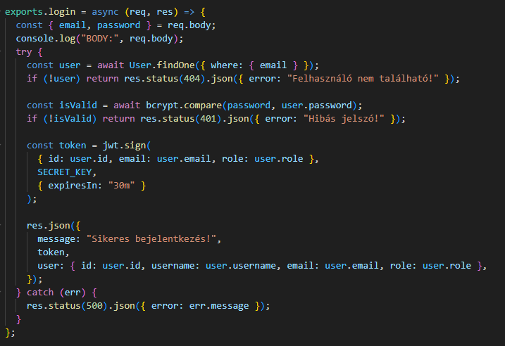
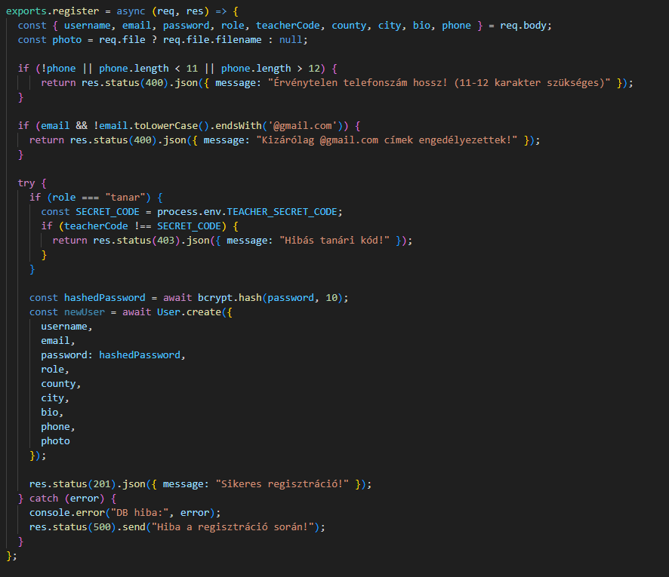
Backend login/registration
The first image shows the login. Here is a brief description of how it works. It retrieves the email address and password from the registration. When someone wants to log in to the site, it first checks whether such an email address is stored in the database. If so, it checks the password, and if everything is correct, it generates a JWT token.
The second image shows the register. It works by extracting all the data entered on the form. If someone wants to register as a teacher, they must enter a teacher code. If they do not enter one or it is incorrect, they cannot register as a teacher. After this, we encrypt the password and create the table in the database.

Slide 4
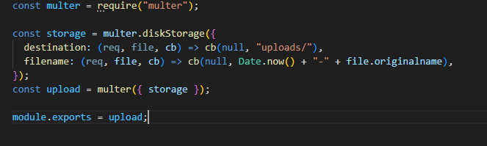
Backend multer
This code snippet uploads files (images, documents) to the
server.
It determines where and under what name the uploaded files will be stored,
sets a unique name for the files, and then creates a multer
object, which will be the middleware responsible for uploading the file.

Slide 5
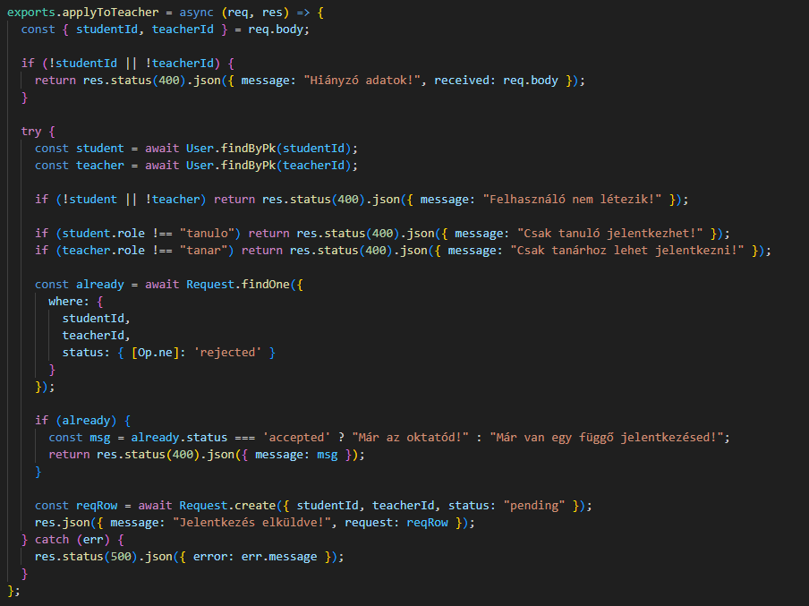
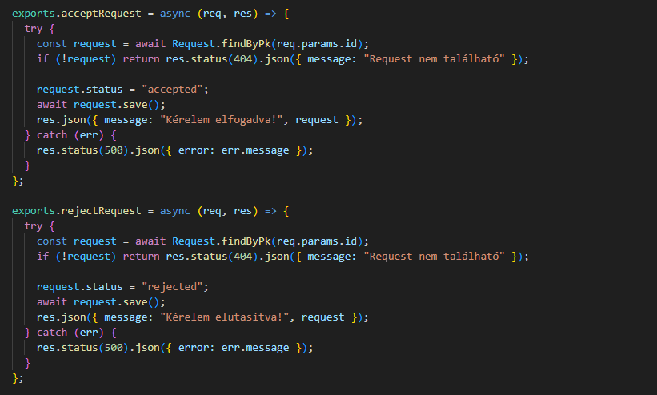
Student application
First, we check whether all the data is there and whether the user exists. If everything is OK, we check whether the application has been received by the teacher who applied. If so, we save it in a table called Request and its status becomes pending.
There are two buttons on the front end: accept and decline. If the teacher accepts, the status in the database changes to accepted; if they decline, it changes to rejected.

Slide 6
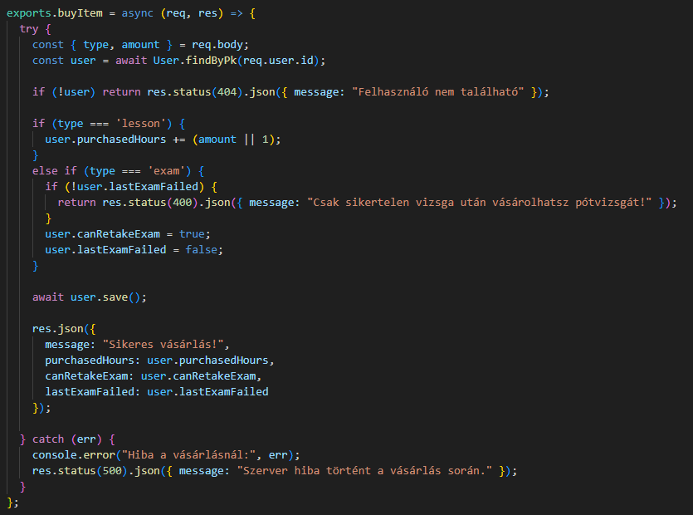
Purchase
First, we check whether the user exists.
If the student has failed their exam, only then can they take lessons or accept students.
If the request is successful, the purchased item is added to the basket, where you can continue shopping.
If something is wrong, we receive an error code.

Slide 7
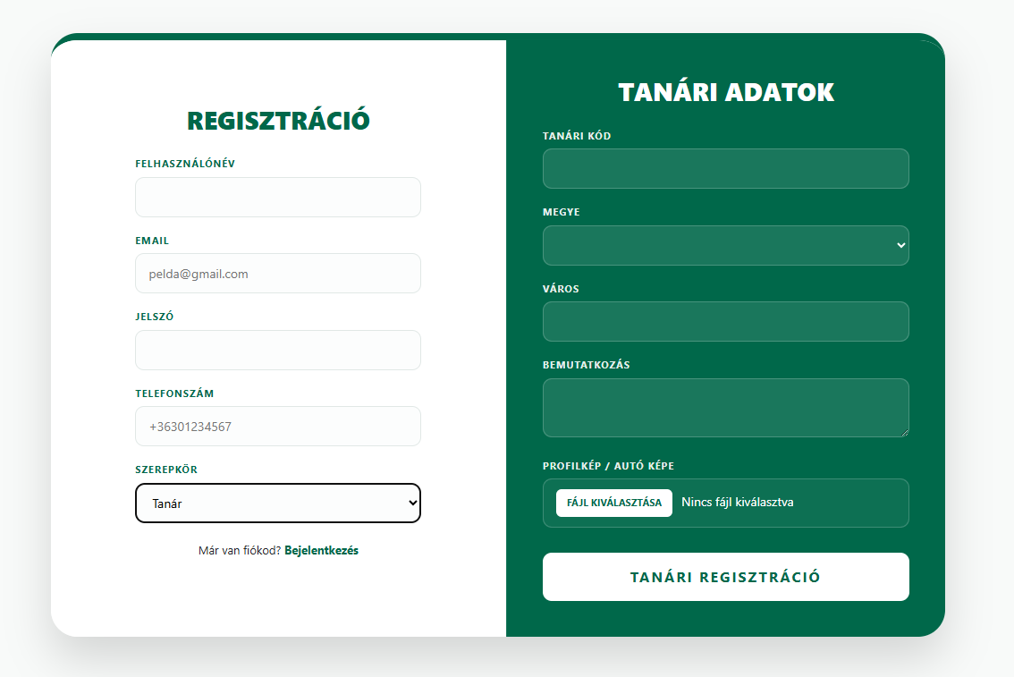
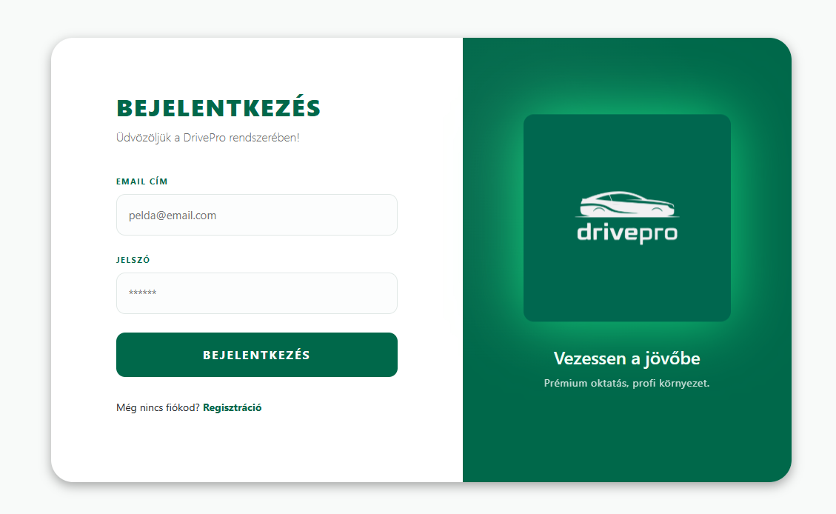
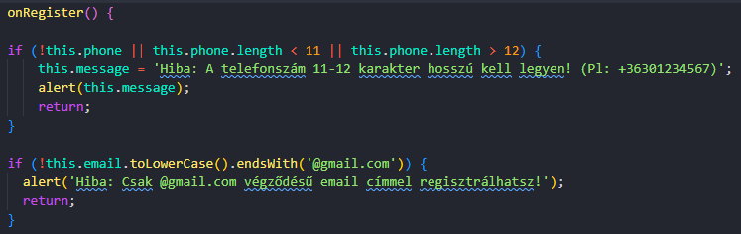
Login/Registration Page
Role-Based Registration: Dynamic card that instantly adapts the form based on whether the user is registering as a Student or a Teacher.
Strict Data Validation: Built-in front-end checks ensuring high-quality data (11-12 digit phone numbers, restricted to @gmail.com email addresses).
Modern UI/UX Design: A responsive, animated split-card layout with a clean green-and-white brand aesthetic that provides a premium user experience.

Slide 8
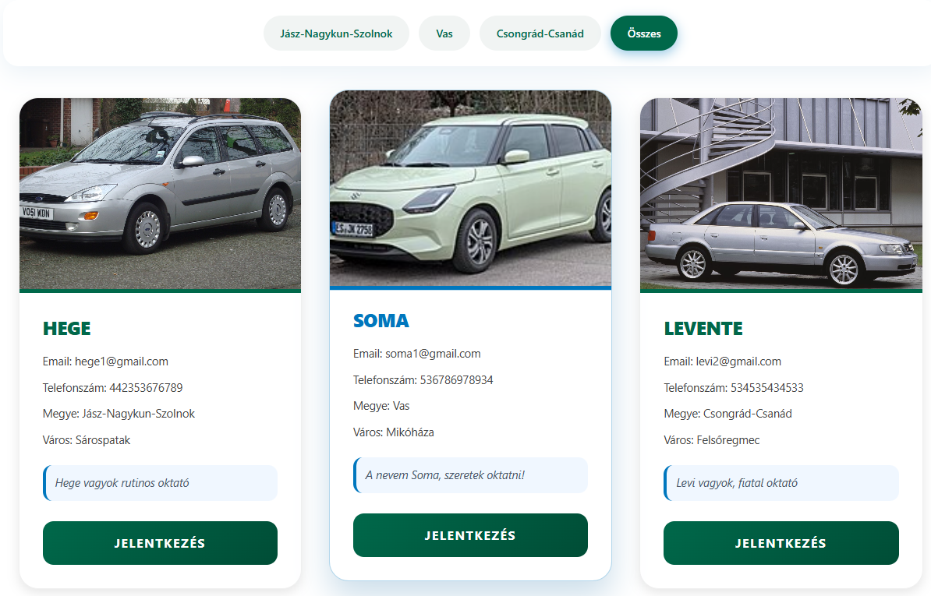
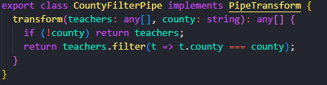
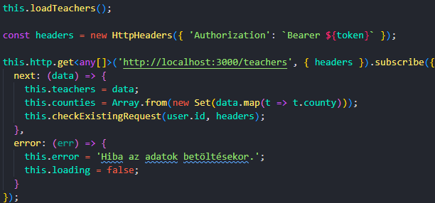
Teachers Page
Dynamic County Filter: A built-in, real-time filtering system (Angular Pipe) that allows students to seamlessly browse instructors by region (counties) without reloading the page.
Detailed Instructor Profile Cards: A responsive card layout that instantly displays the instructor's photo, contact information (email, phone), location, and personal bio.
Real-Time Status Tracking: The system provides immediate feedback on the application status (e.g., "Pending"), preventing multiple or duplicate applications.

Slide 9
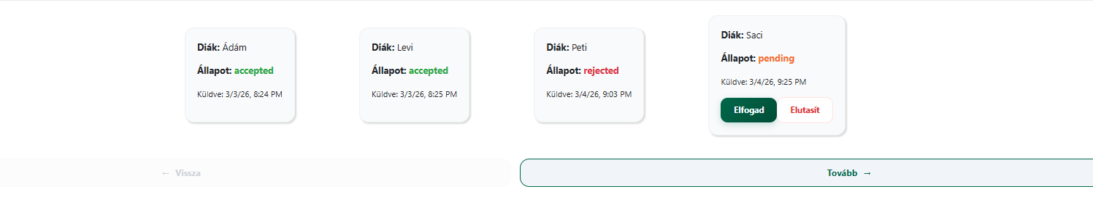
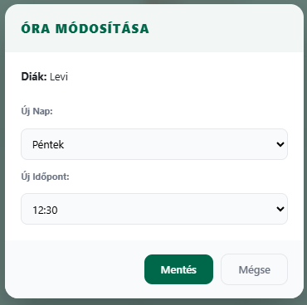
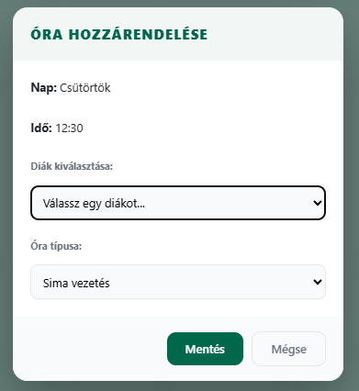
Schedule Page
Built-in Request Manager: Instructors can review, approve, or reject student connection requests on a dedicated, slider-based interface.
Dynamic Calendar View: An interactive, cell-based schedule where instructors can assign driving lessons or exam slots to students with a single click (using pop-up Modals).
Role-Specific UI: The same component intelligently adapts to the user: students see only their own schedule, while instructors can manage their full capacity and student assignments.

Slide 10
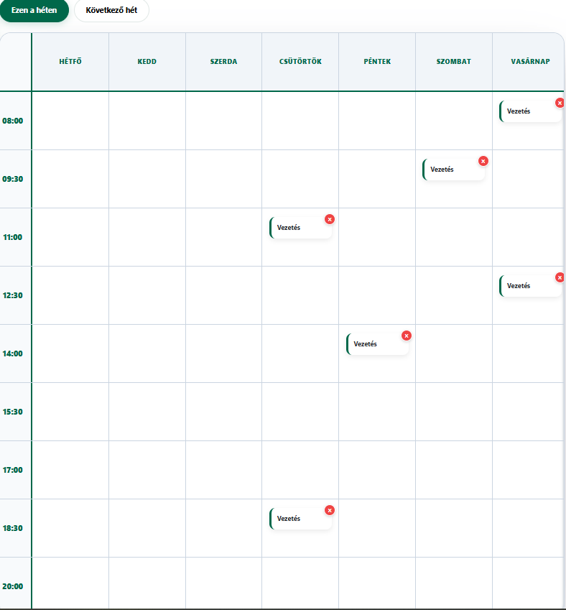
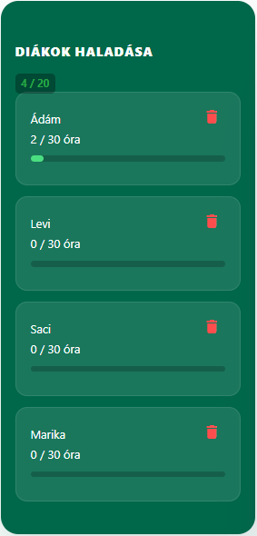
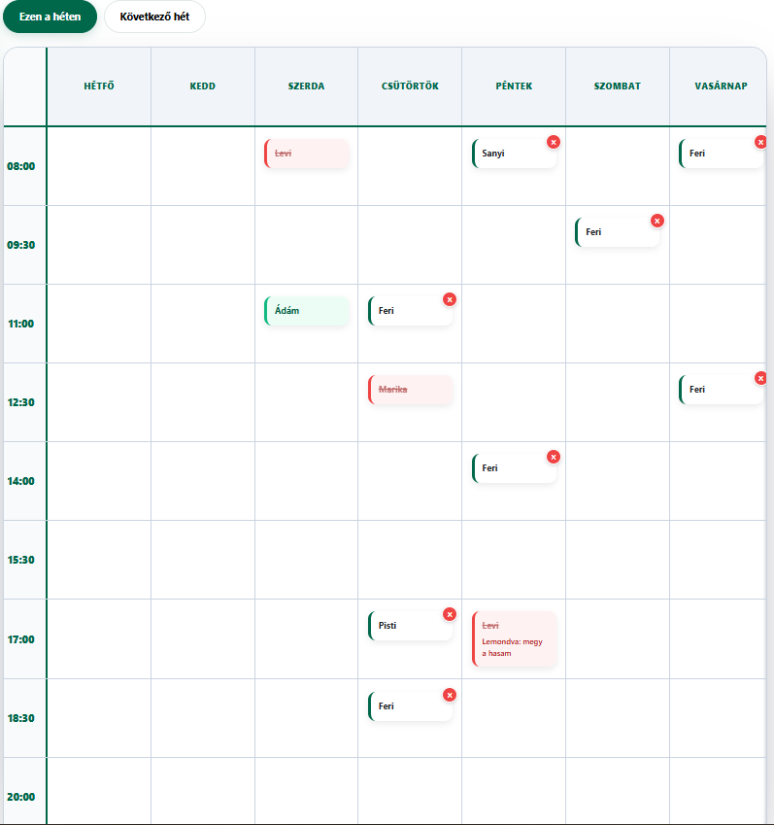
Schedule Page
Smart Exam Logic & Extra Lessons: The system automatically checks exam eligibility (e.g., required hours completed). If a failed exam is recorded, the interface immediately offers the option to purchase extra (remedial) lessons.
Color-Coded Status Tracking: Visual feedback in the calendar provides an easy overview (e.g., green for a passed exam, orange for upcoming, red for failed/rejected).

Slide 11
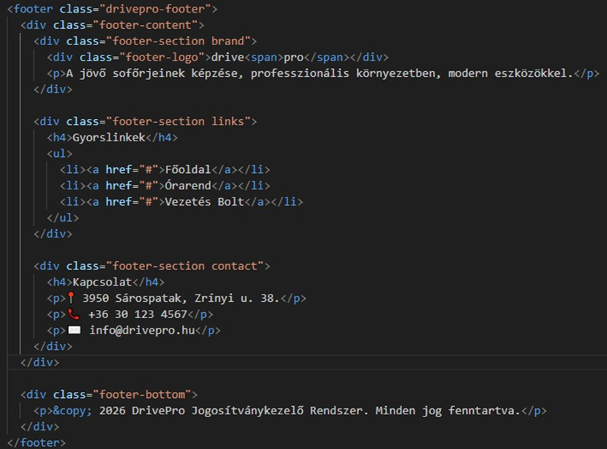
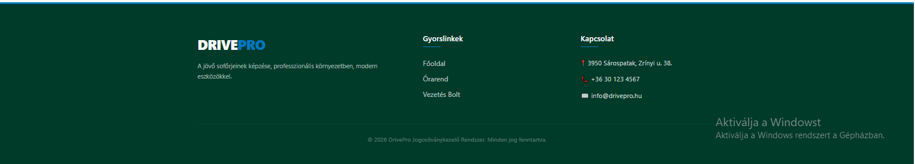
Navbar and footer
The DrivePro website features a consistent dark green theme across its header and footer. The header includes a minimalist logo with a car silhouette and a navigation menu with "FŐOLDAL" (Home), "BEJELENTKEZÉS" (Login), and "REGISZTRÁCIÓ" (Registrcolumns: a brand mission statement, a "Gyorslinkekation). The footer is organized into three " (Quick Links) section for the home page, schedule, and shop, and a "Kapcsolat" (Contact) section providing an address in Sárospatak, a phone number, and an email. The bottom of the page displays a 2026 copyright notice for the DrivePro License Management System.

Slide 12
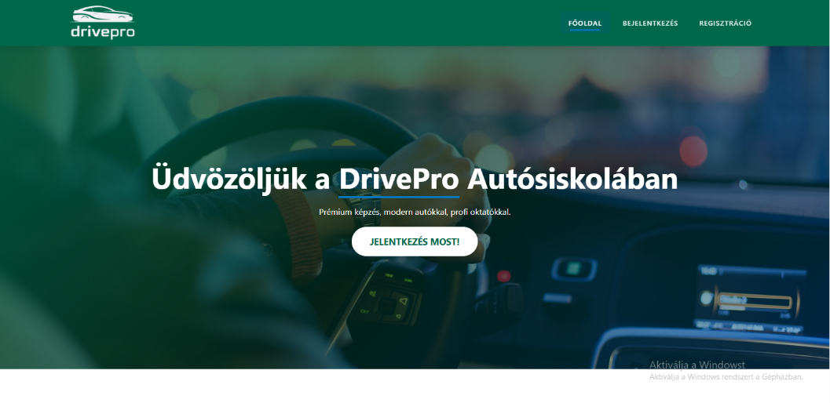
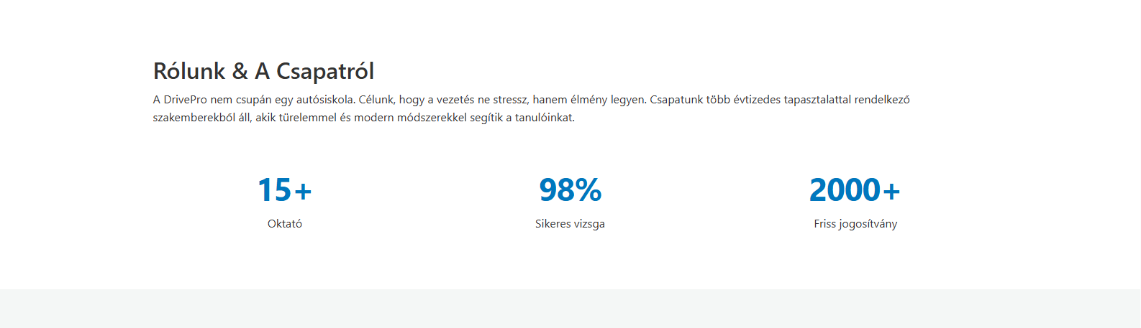
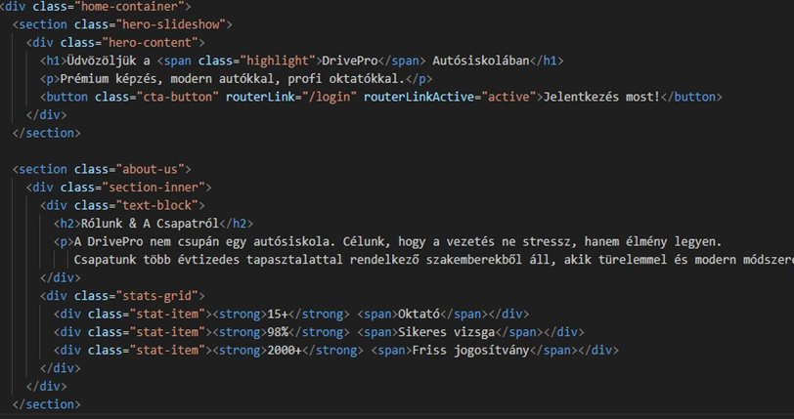
Mainpage Welcome and introduction
The DrivePro Driving School homepage features a modern hero section with a driving-themed background, professional headlines, and an Angular-powered "Apply now!" button for seamless navigation. Below, the "About Us" section emphasizes stress-free learning, supported by a grid-based statistics block showcasing 15+ instructors, a 98% pass rate, and over 2,000 licenses issued. The site’s semantic HTML structure ensures a clean, professional, and transparent user experience.

Slide 13
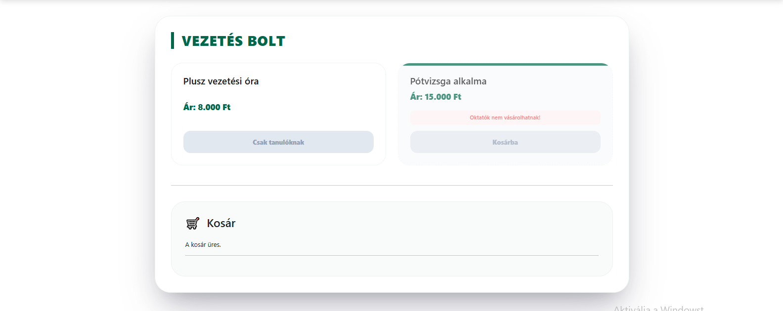
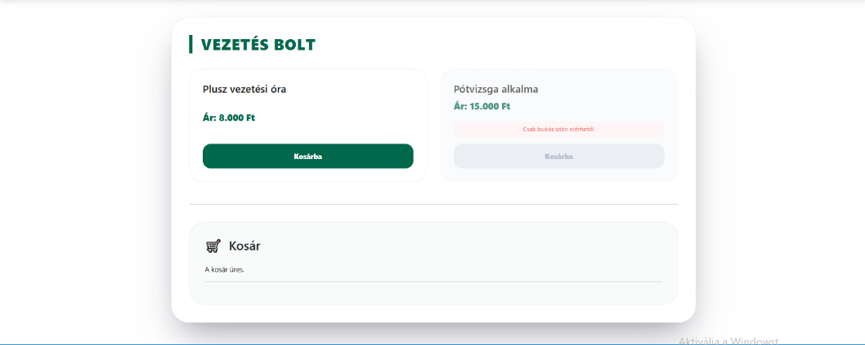
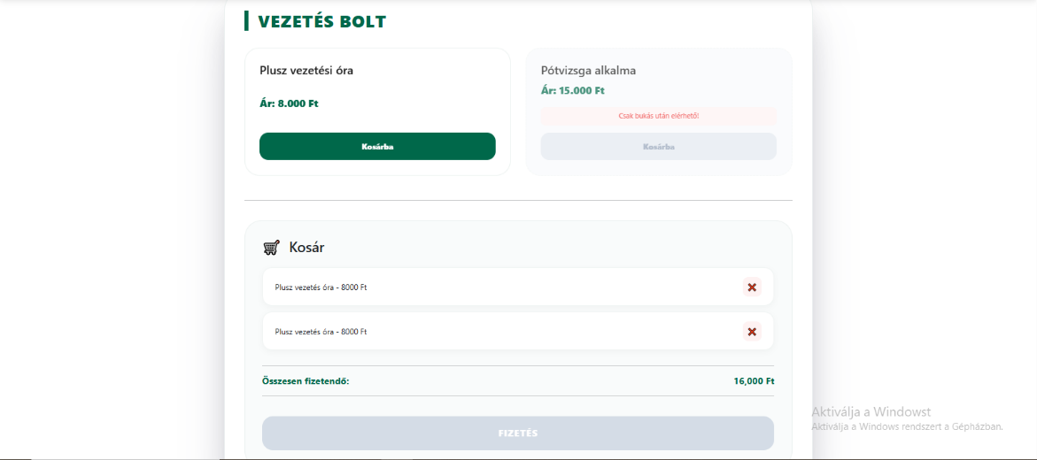
Cart
The images and code show the DrivePro „Driving Store" page, where students can purchase additional services. Two products are available: extra driving lessons (8,000 HUF) and a retake exam(15,000 HUF).The system takes into account the role of the user. Instructors can not make purchases; the buttons are disabled for them. The retake exam is only available if the student failed the previous exam. At the bottom is the basket, where the selected items are listed and can be deleted, and the total amount to be paid is automatically calculated. If the basket is empty, this is indicated by a separate message.

Slide 14
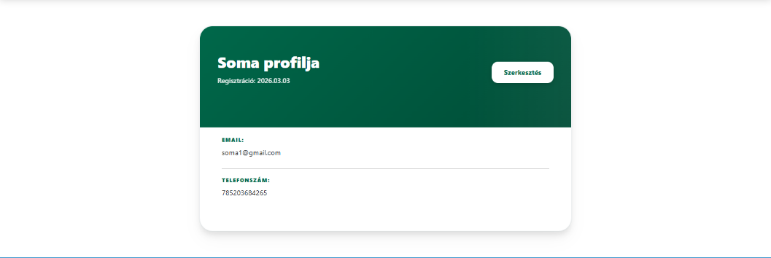
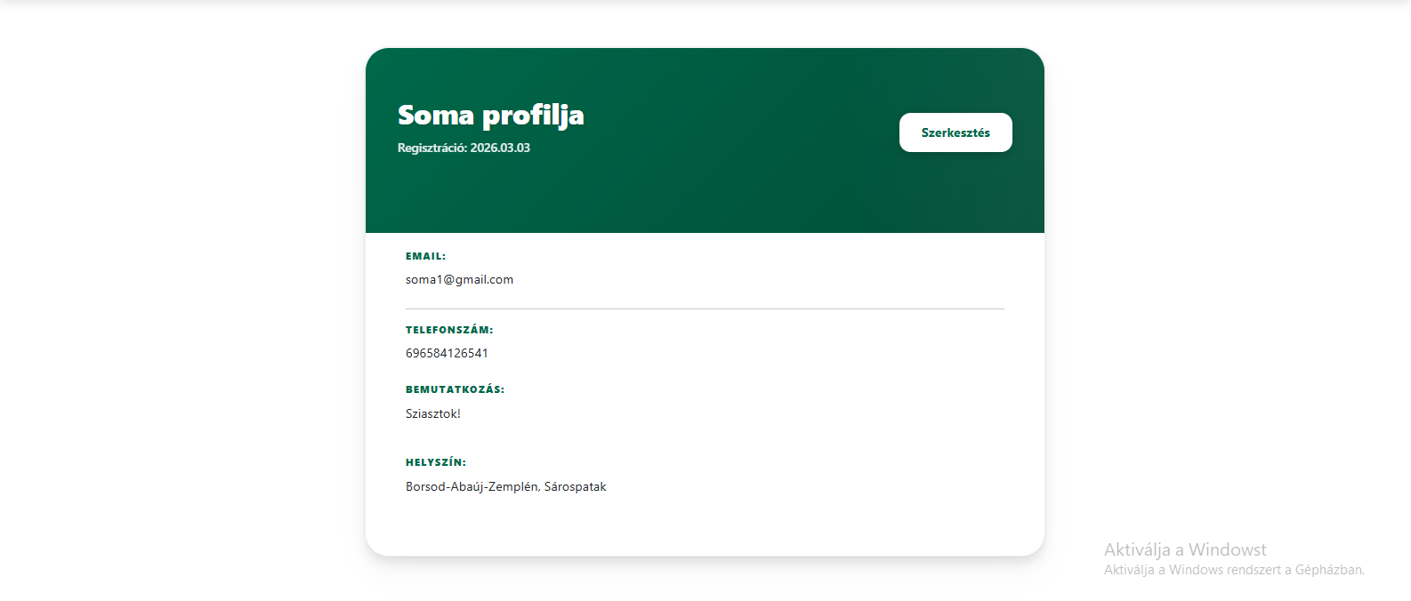
Student and teacher profile
The DrivePro profile interface provides a clean, card-based layout for both students and teachers, clearly separating view and edit modes. The upper section displays the user's name, registration date, and an edit button, while the main body contains essential contact information like email and phone number. In edit mode, users can update their details and change their password by entering both old and new credentials. The teacher-specific view offers additional functionality, such as uploading a profile picture and selecting their location from a county dropdown list.

Slide 15
Thanks for your attention

